Slide 1
Ring Oscillator
Presented By
Madhukar Saini

Slide 2
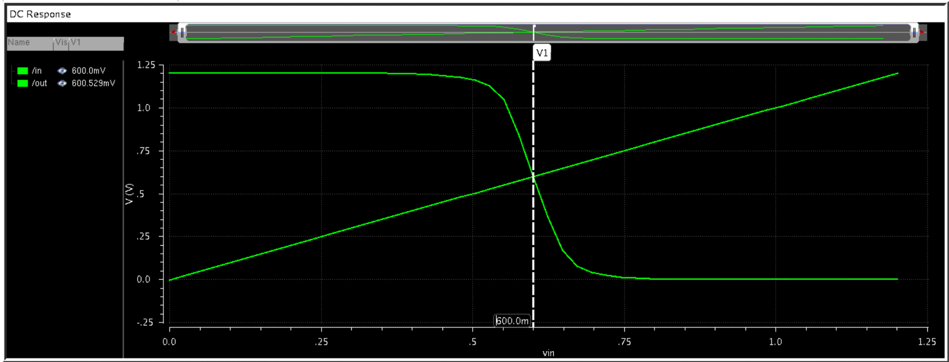
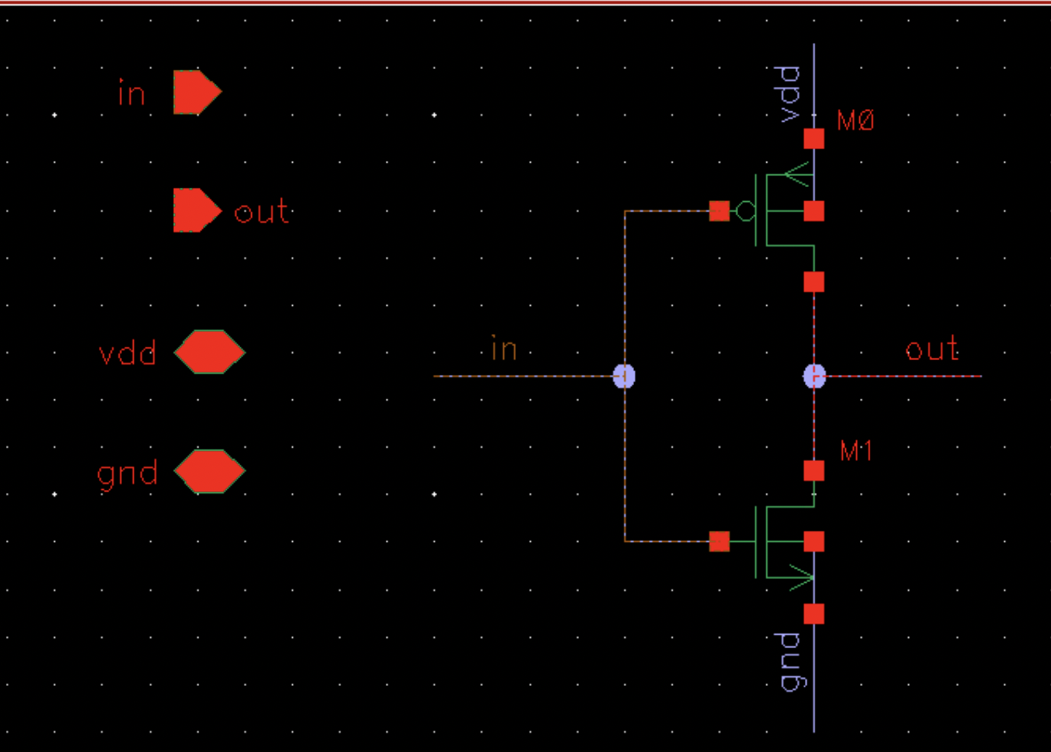
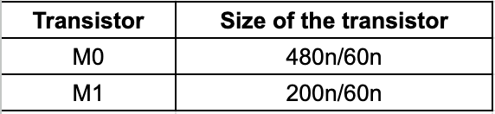
Making RISE time and FALL time same for inverter

Slide 3
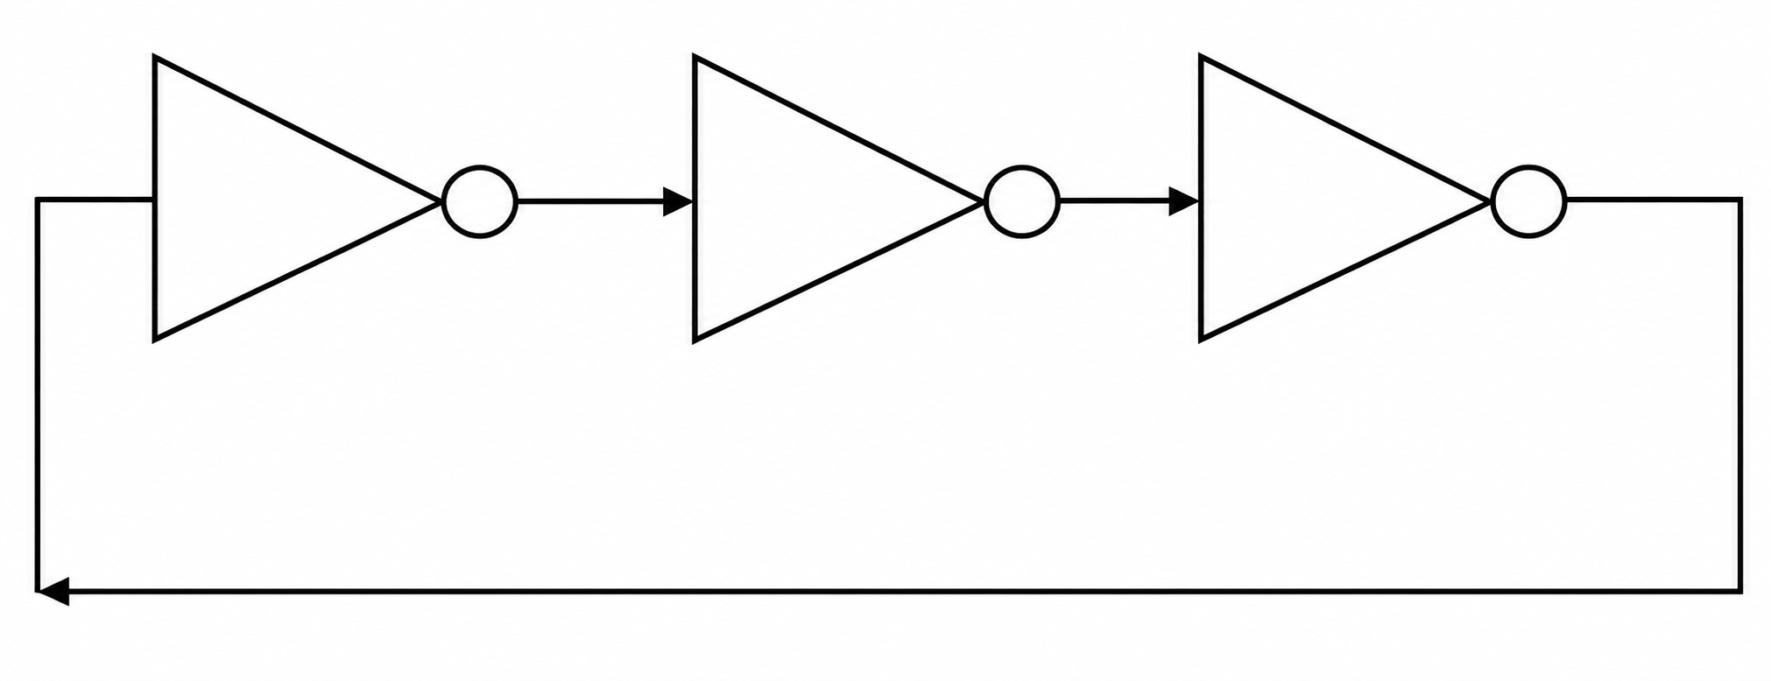
Ring Oscillator
A ring oscillator is a digital/analog timing circuit consisting of an odd number of inverting stages connected in a closed loop.
The feedback causes the circuit to oscillate without an external clock.
The oscillation frequency is primarily determined by the propagation delay of each inverter stage. When the number of stages increases the frequency will decrease as each stage introduces delay in the signal path.
a
b
c
Inverter1
Inverter 2
Inverter 3

Slide 4
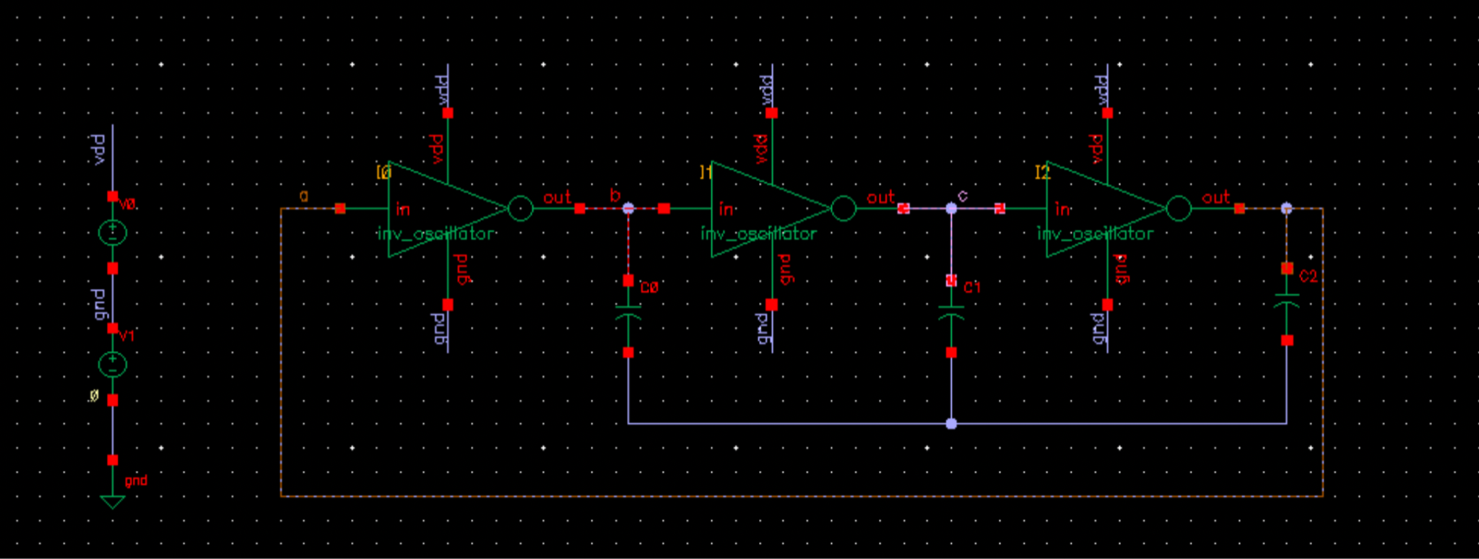
Schematic

Slide 5
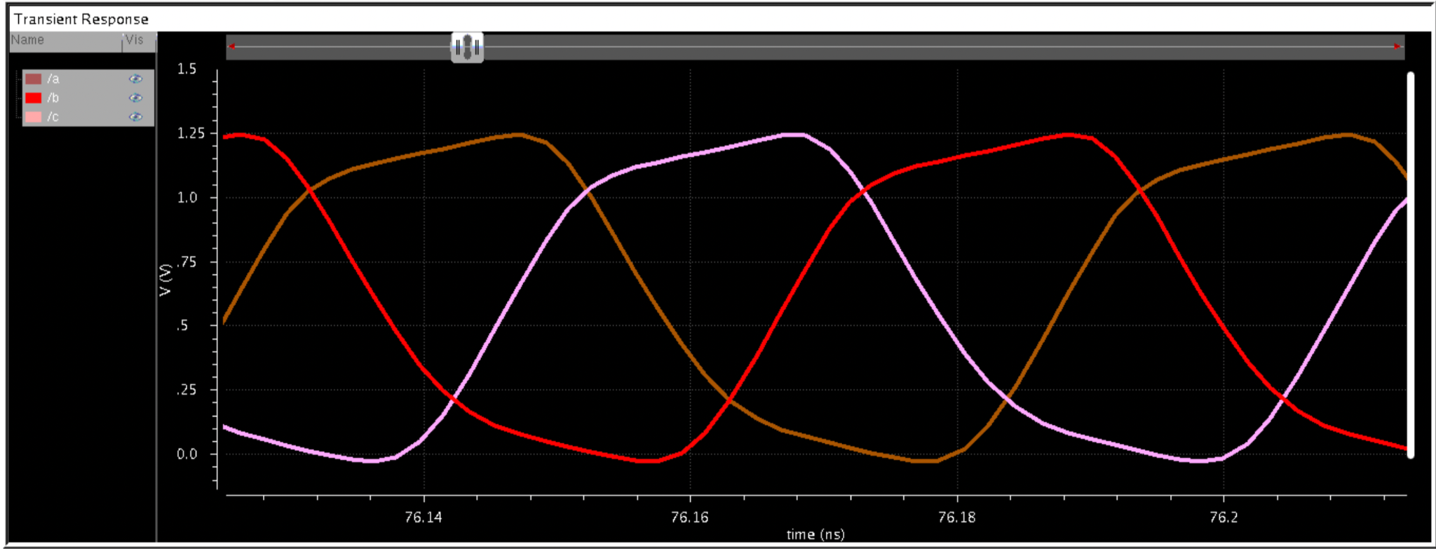
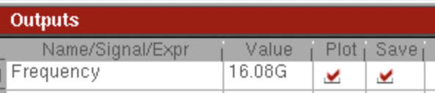
Frequency with CL = 0 fF

Slide 6
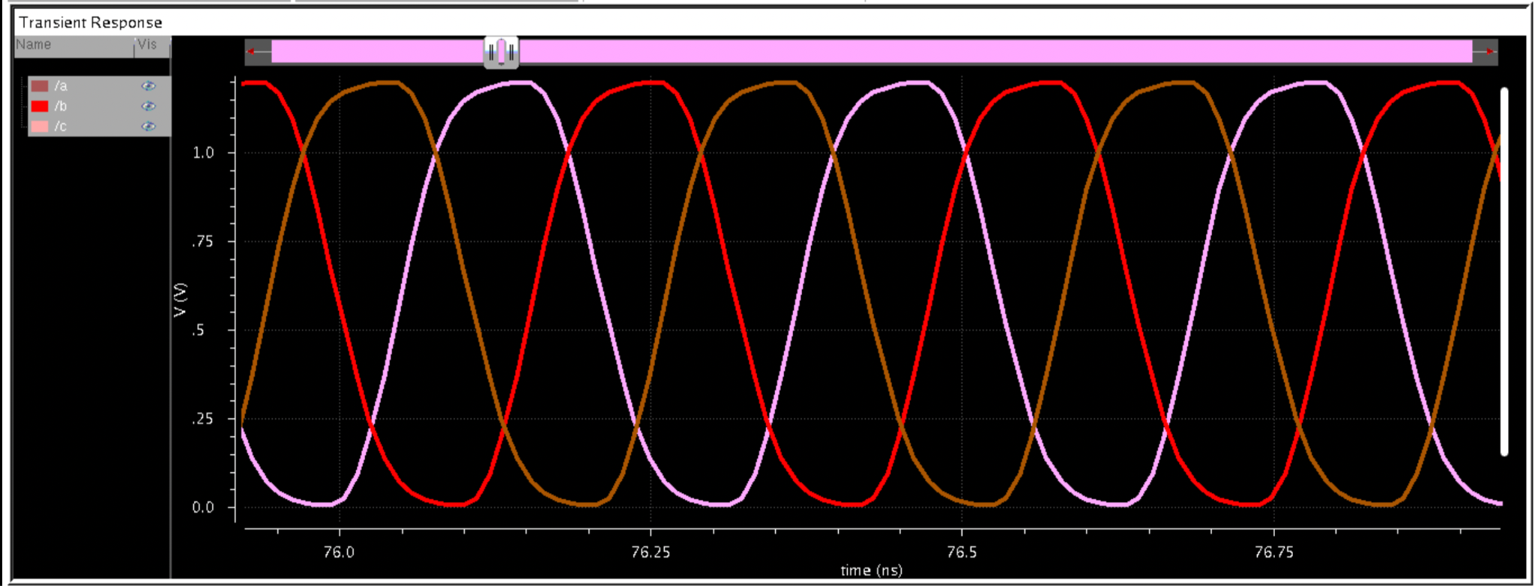
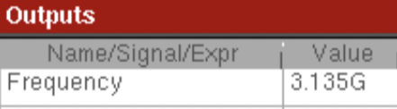
Frequency with C_{L} = 5 fF

Slide 7
Frequency Modification
Frequency without any load capacitance at each stage of the inverter.
The the frequency is 16.08GHz.
The frequency with known capacitance 5fF as load at each stage of the inverter is 3.128GHz
Frequency without load capacitance is F_{OSC} = 1/(2NRC_{G})
Frequency with load capacitance 5fF at each stage of the inverter is F_{OSC1} = 1/(2NR(C_{G}+C_{L})
F_{OSC} /F_{OSC1} = 1/(2NRC_{G})/(1/(2NR(C_{G}+C_{L})) From F_{OSC} = 16.08GHz, F_{OSC1} = 3.128GHz and C_{L} = 5fF
C_{G} = 1.2fF
To make FOSC1 = 5GHz
F_{OSC} /F_{OSC1} = 1/(2NRC_{G})/(1/(2NR(C_{G}+C_{L})) From F_{OSC} = 16.08GHz, F_{OSC1} = 5GHz and C_{G} = 1.2fF
C_{L} = 2.695fF
As the load capacitance will add delay, the frequency will be modified inversely with load capacitance

Slide 8
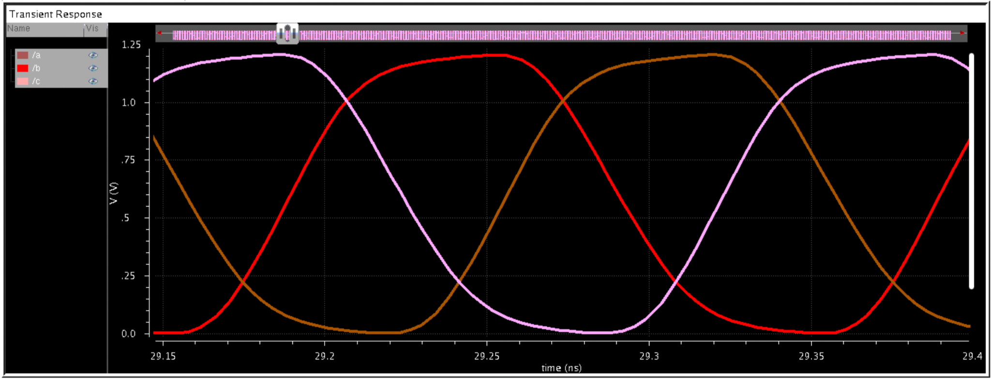
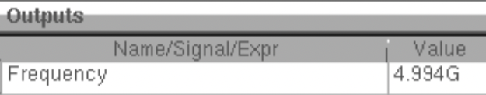
Simulation for Modified Frequency

Slide 9
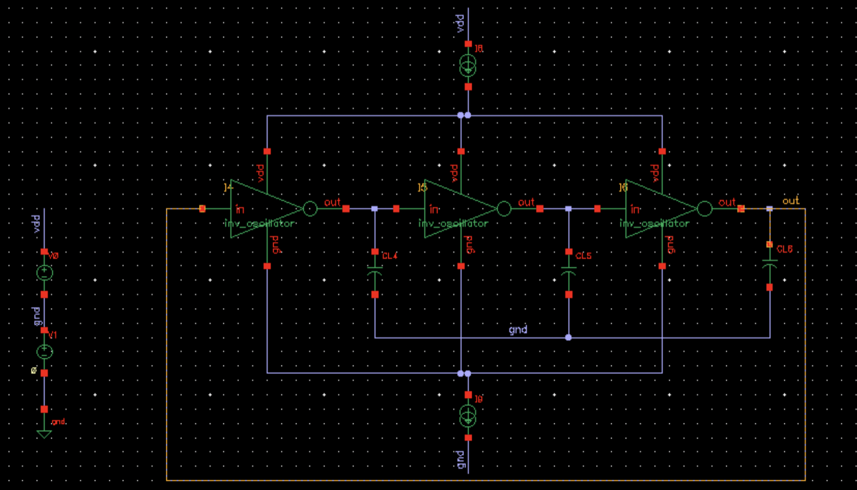
Schematic - Changing the delay
Frequency can be changed by changing rise and fall time of inverter by pumping the current to the inverter.

Slide 10
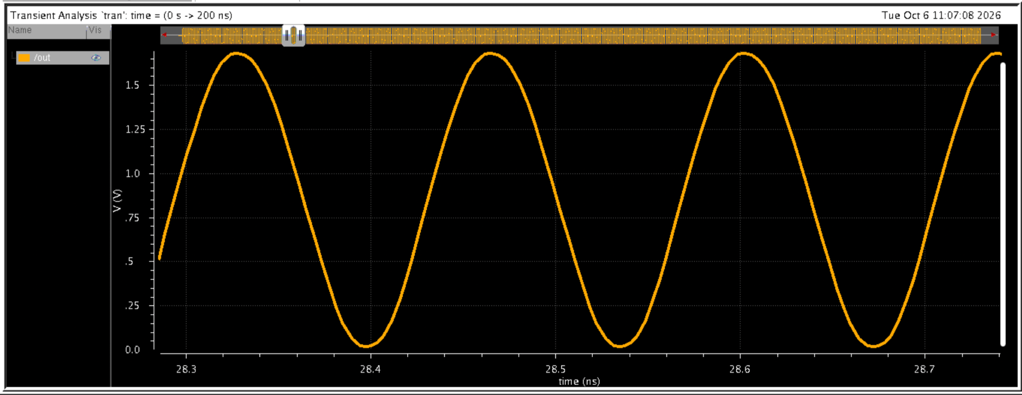
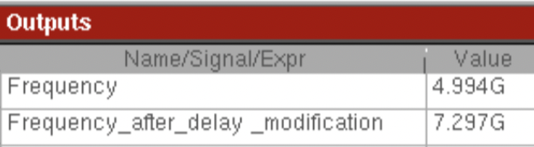
Results - Changing the delay (Id = 200uA)
Frequency can be changed by changing rise and fall time of inverter by changing the current pumped to the inverter.

Slide 11
Note for Process Variation
Though the ideal capacitance at the output of each inverteris used, the ON resistance of inverter change with the process variation, resulting variation in oscillator frequency for each process.
That is the reason why we generally prefer to use ring oscillator in the loop.

Slide 12
Thank You

